Slide 1
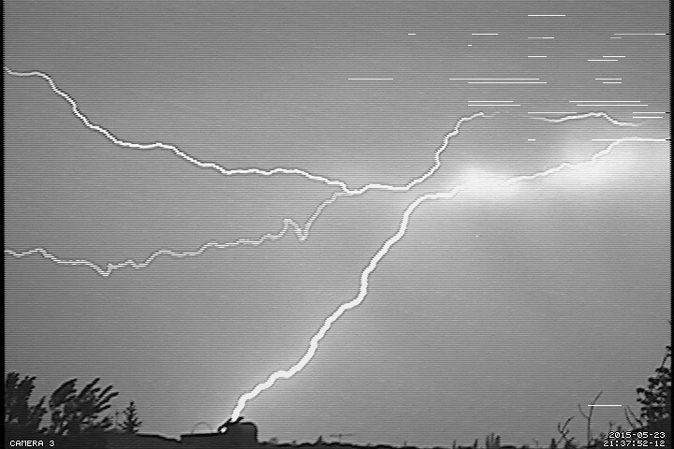
First results on the Optical monitoring of the atmospheric discharges on Aragats and in Burakan: the storage, on-line display of multiple photographs
A. Chilingarian, H. Dermenjyan, A. Reymers and S. Mkoyan A.Alikhanyan National Laboratory (Yerevan Physics Institute) Cosmic Ray Division harutyun@yerphi.am

Slide 2
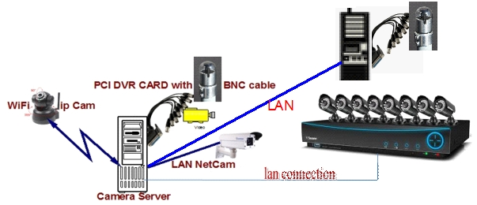
Preferred Network Video Recorder/Digital Video Recorder (NVR/DVR) system.
To decide a suitable place and Set up cameras.
To understand a suitable DVR/NVR System.
We all know that almost all cameras have their built-in softwares with a lot of various functions and opportunities, but on the other hand they are very limited in their ability and doesn’t allow to develop so to meet to our needs. So instead we prefer to develop DVR/NVR software working on Linux system which allows us to get images almost from any type of cameras, DVRs and from any type of connections: network cameras, cameras with BNC cable, USB cameras and other. Developing system gives us the opportunity to be flexible, using any type of scripts and other external codes and provide control and operation, also act as DVR and NVR simultaneously.
Install appropriate software to connect to our NVR system even if their default connection method will differ from type of NVR.
If for some reason camera(s) has been connected to another type of system, in this case one of the solutions to setup an appropriate software in that system in order to get a video streaming path from a base server.

Slide 3
Trigger script to connect camera server with nearby electric field measuring devices.
Create trigger scripts to switch the camera server to motion detection mode when the nearby electric field disturbance enhance predefined threshold.
Due to difficulties in treatment of multi-terabyte video information we plan to capture and store only “interesting” views. For this reason the trigger scripts has been created working with signals from nearby electric field measuring devices. If one of the these devices will register a High Field Alarm Activity only then the server will start the appropriate picture shooting software in motion detection mode instead. Thus we will get only the images registering discharge processes in the atmosphere, which will highly accelerate the data analyzes.
Online display and user-friendly interface for all installed cameras.
Aragats Online Display
Byurakan Online Display
Interface for simplifying the collection and retrieval of already captured photos and movies.
Stored Pictures From Aragats
Stored Pictures From Byurakan

Slide 4
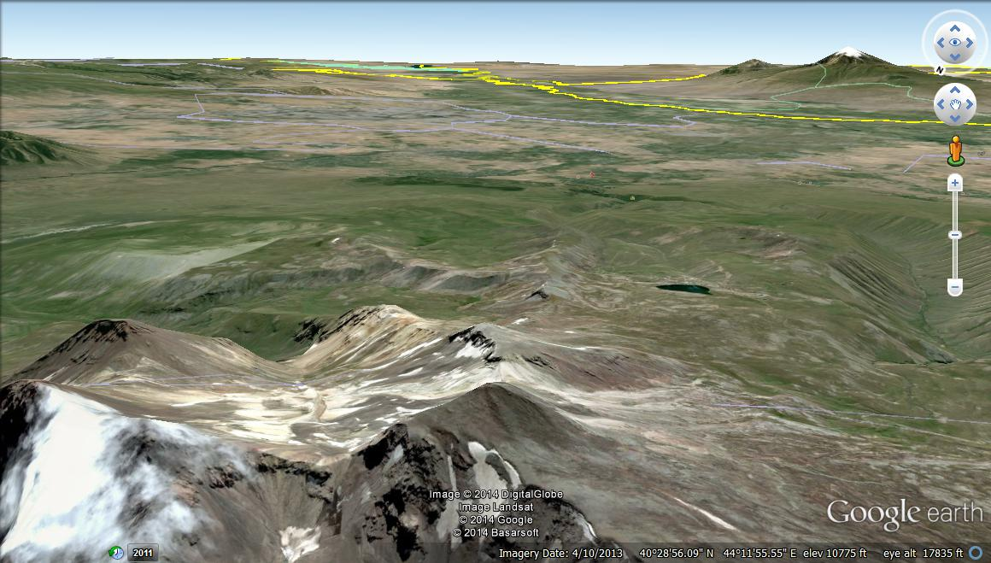
The Geographical locations of The Aragats Cameras
Mount Ararat
Yeravan
All Sky Cam 180°
Geovision gv-bx1500
LINKSYS
LCAD03VLNOD 1080p 3MP
The Lake of Aragats
The Top Of Mount Aragats
The count of the cameras: 3
Framerate: Up to 30fps
The installed height: 3200m.

Slide 5
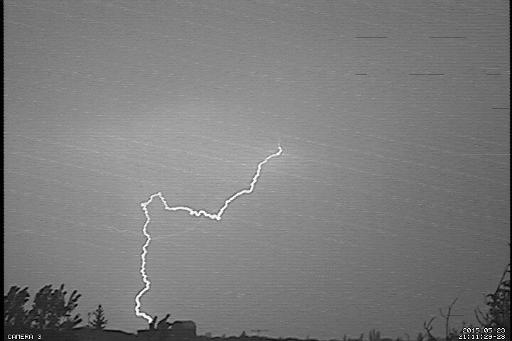
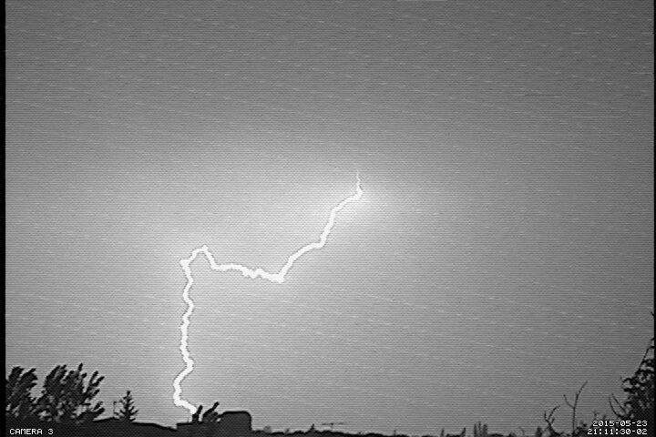
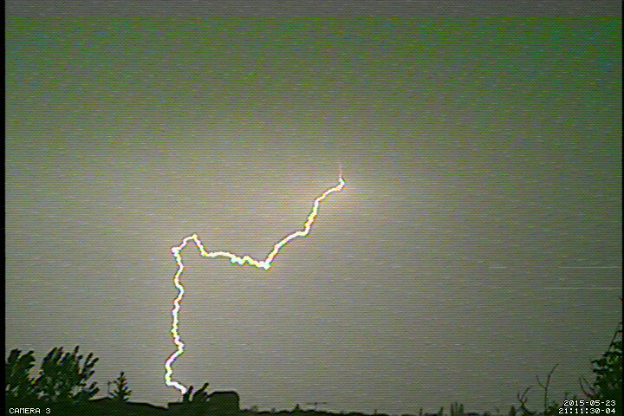
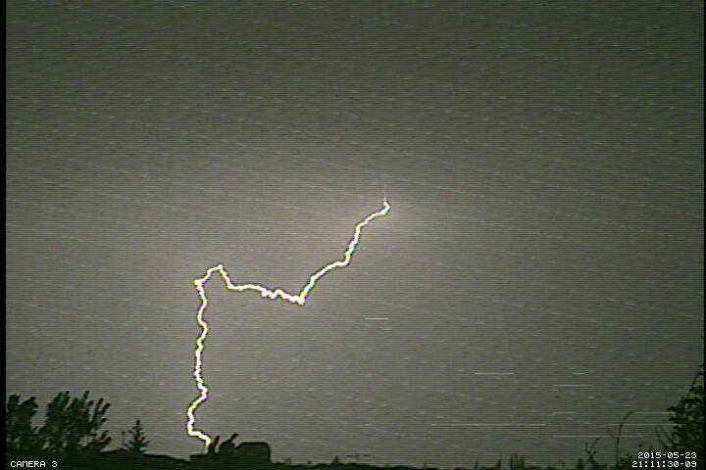
Some Interesting Pictures At Byurakan During 2015.05.23

Slide 6
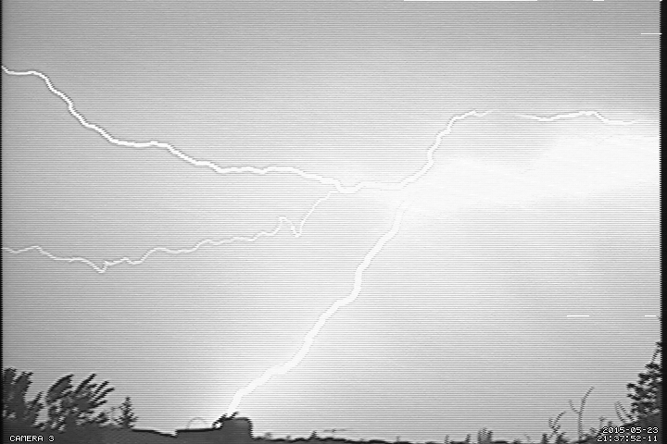
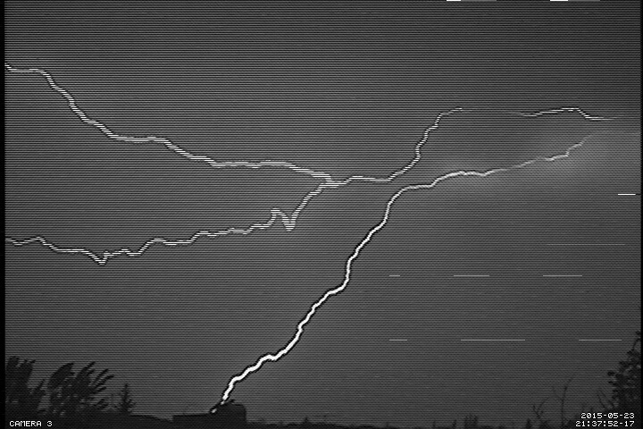
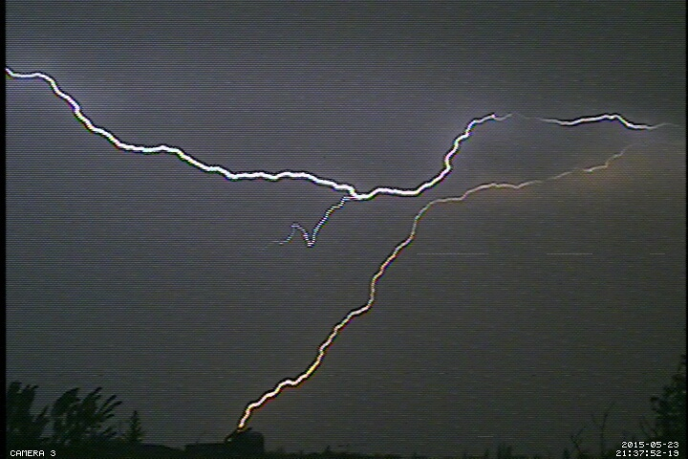
Some Interesting Pictures At Byurakan During 2015.05.23

Slide 7
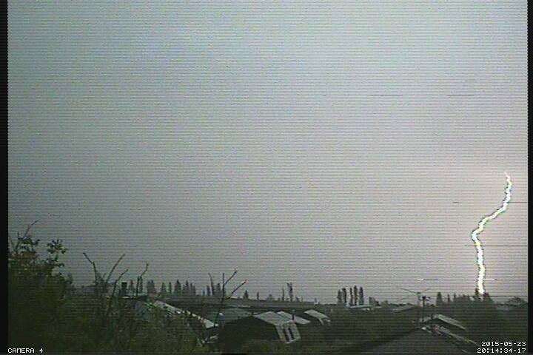
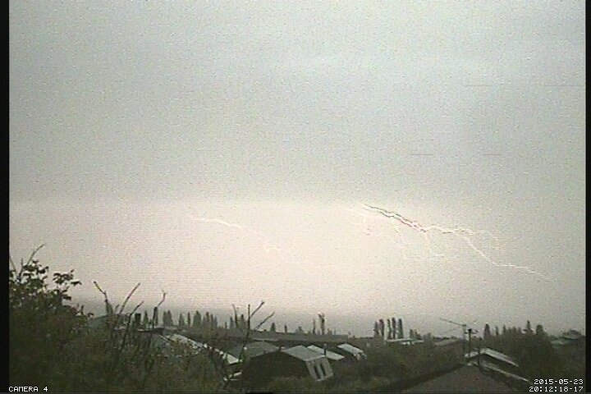
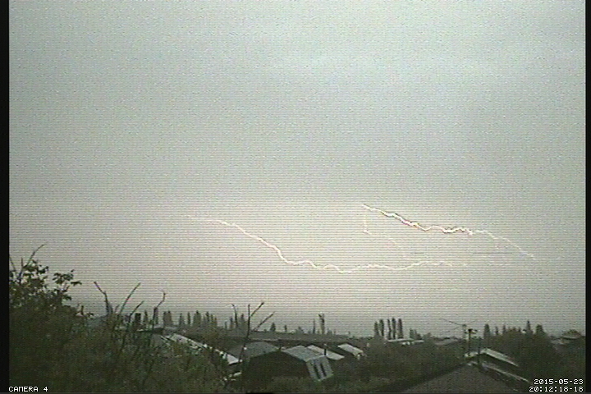
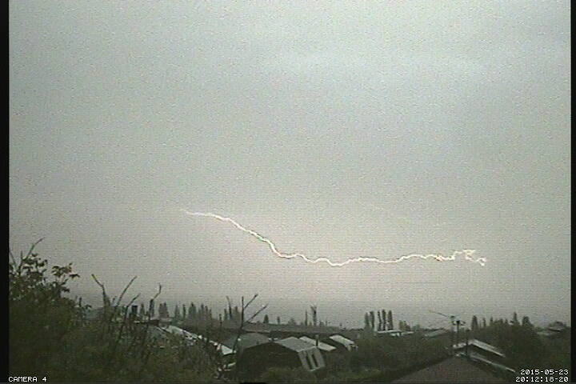
Some Interesting Pictures At Byurakan During 2015.05.23

Slide 8
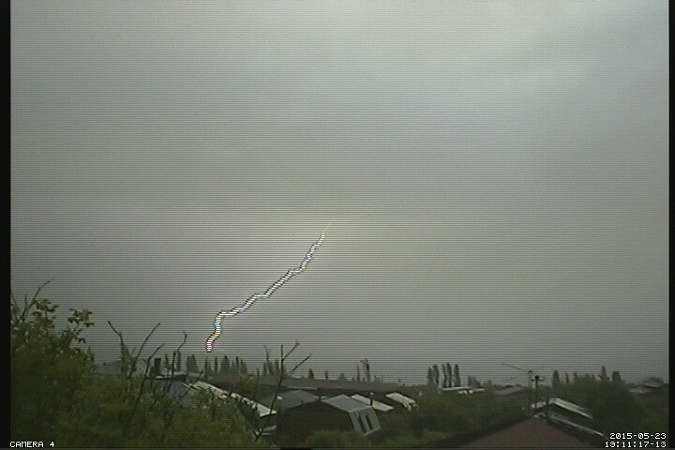
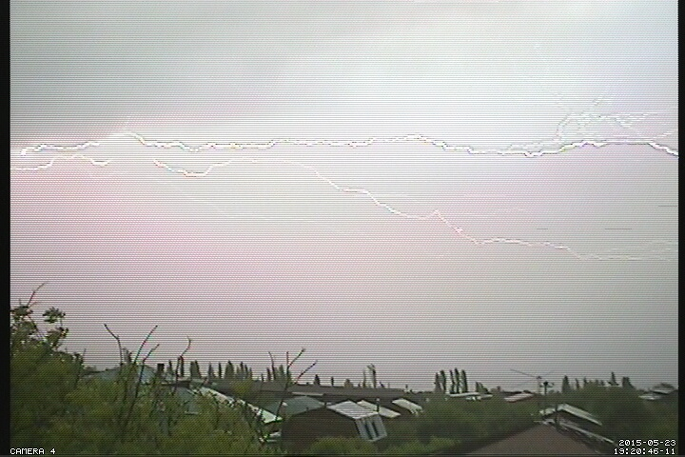
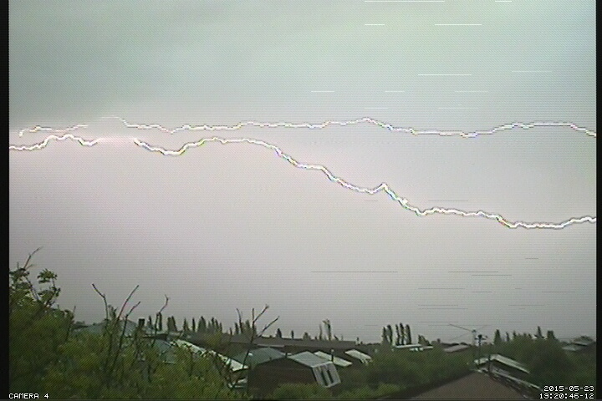
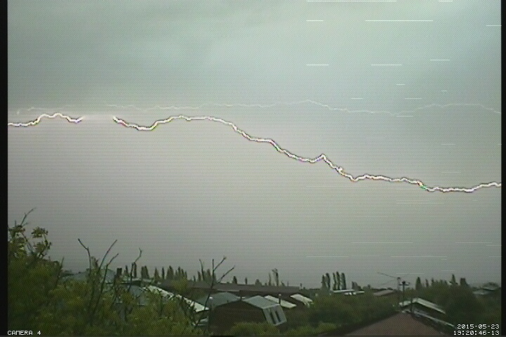
Some Interesting Pictures At Byurakan During 2015.05.23

Slide 9
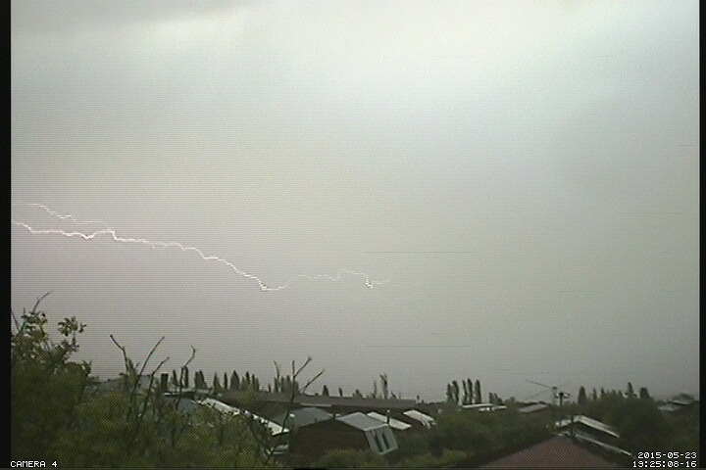
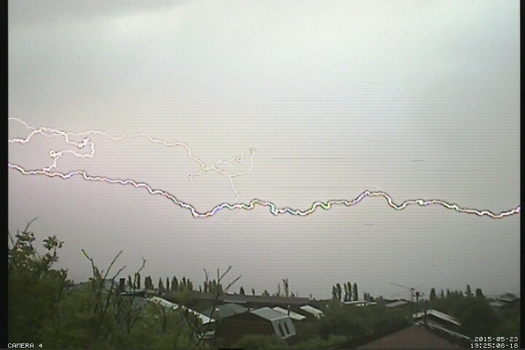
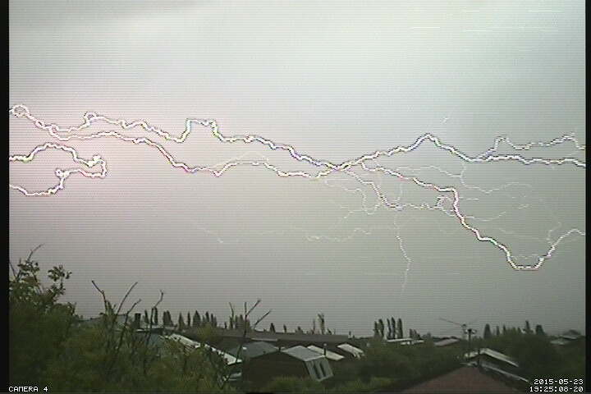
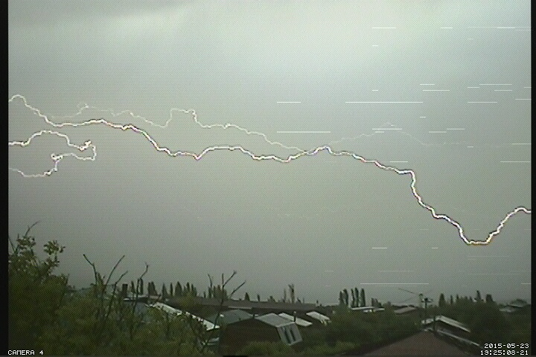
Some Interesting Pictures At Byurakan During 2015.05.23

Slide 10
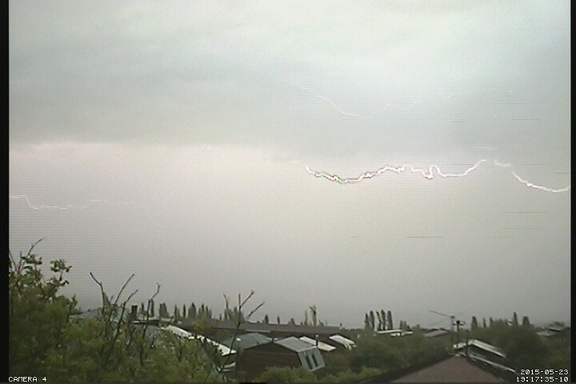
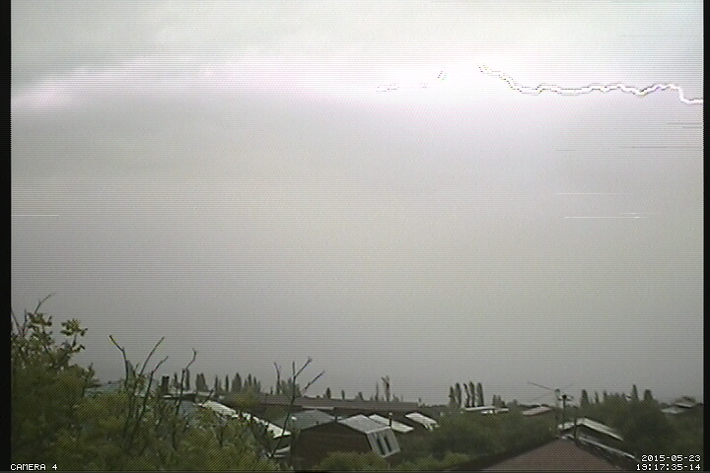
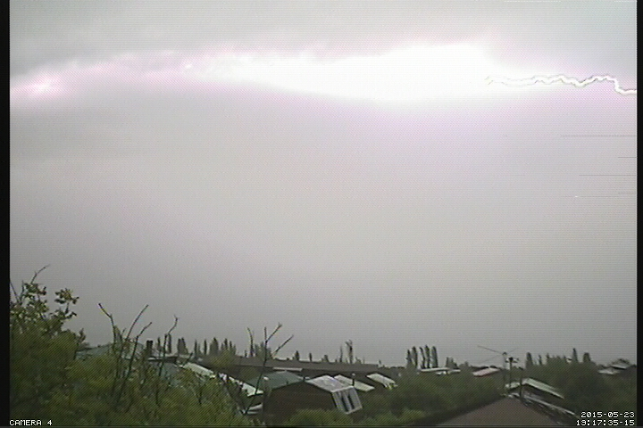
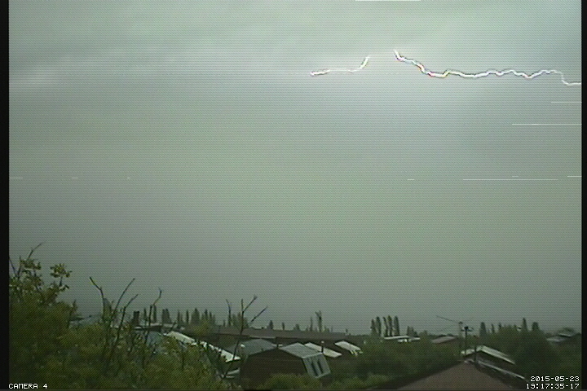
Some Interesting Pictures At Byurakan During 2015.05.23

Slide 11
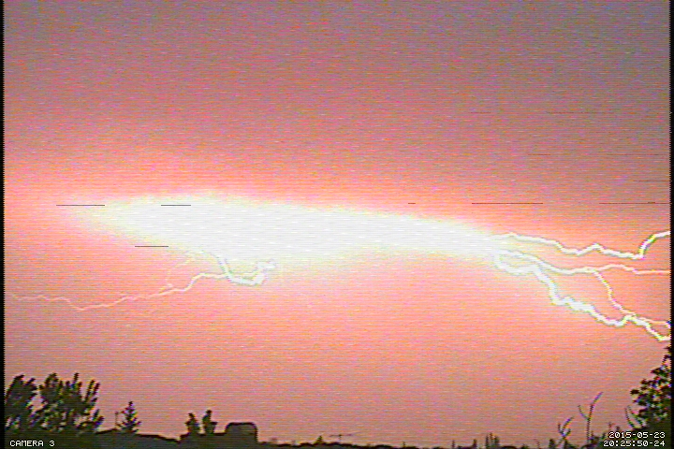
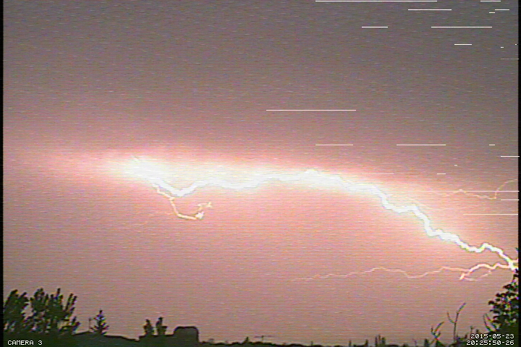
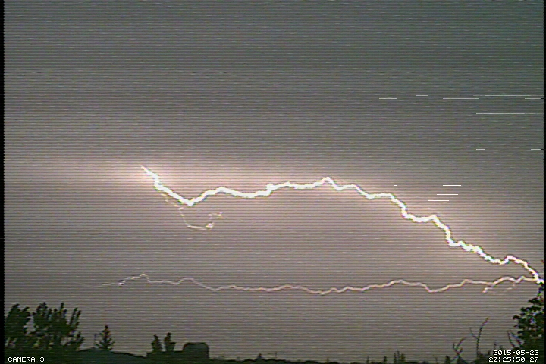
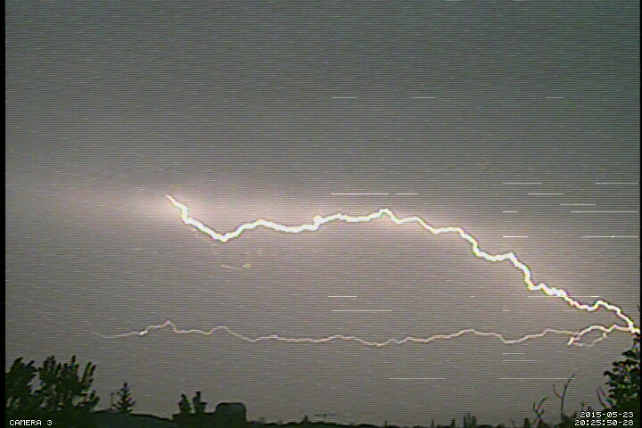
Some Interesting Pictures At Byurakan During 2015.05.23

Slide 12
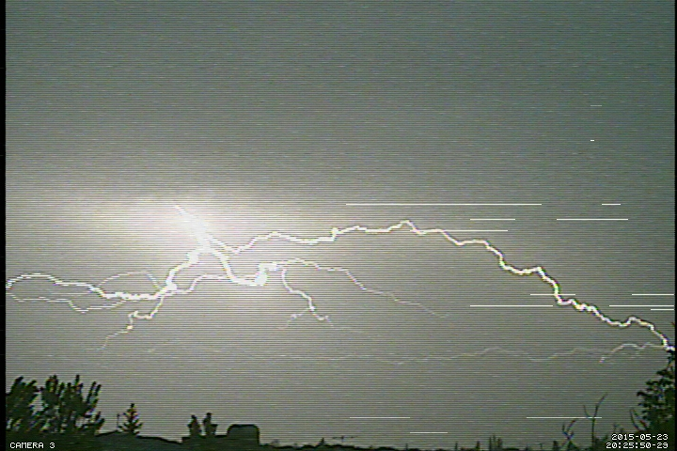
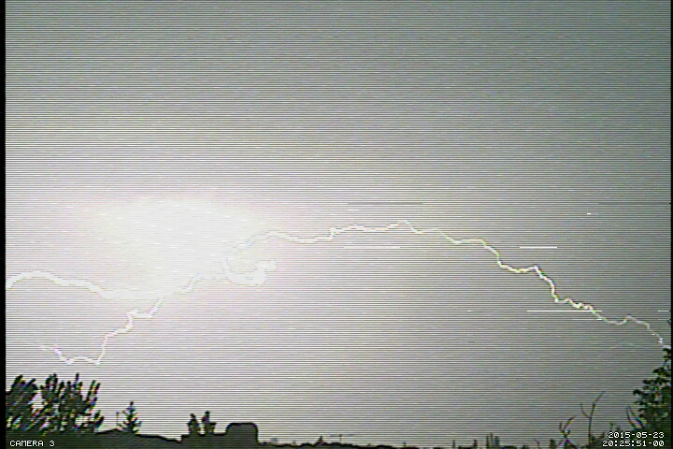
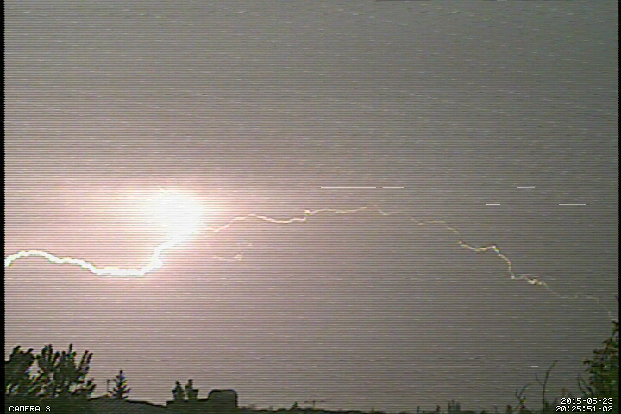
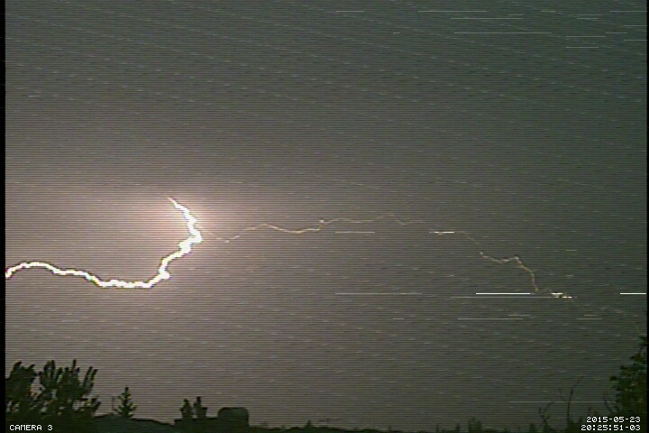
Some Interesting Pictures At Byurakan During 2015.05.23

Slide 13
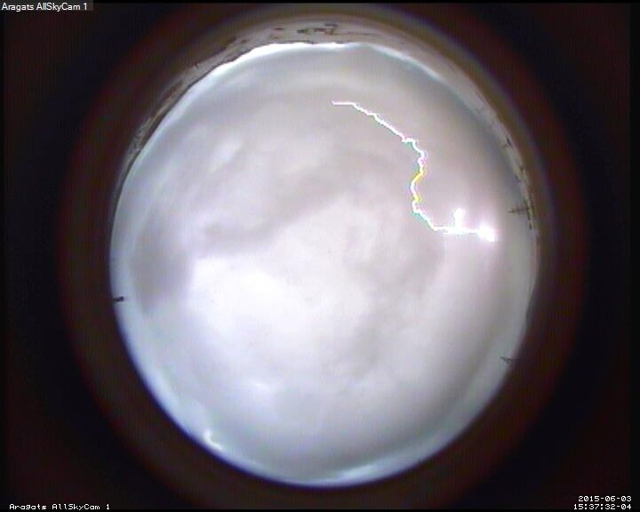
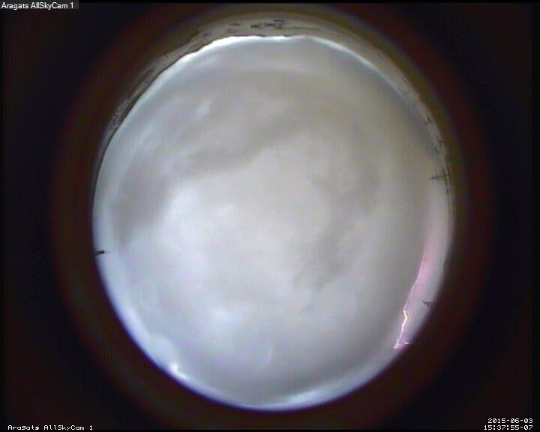
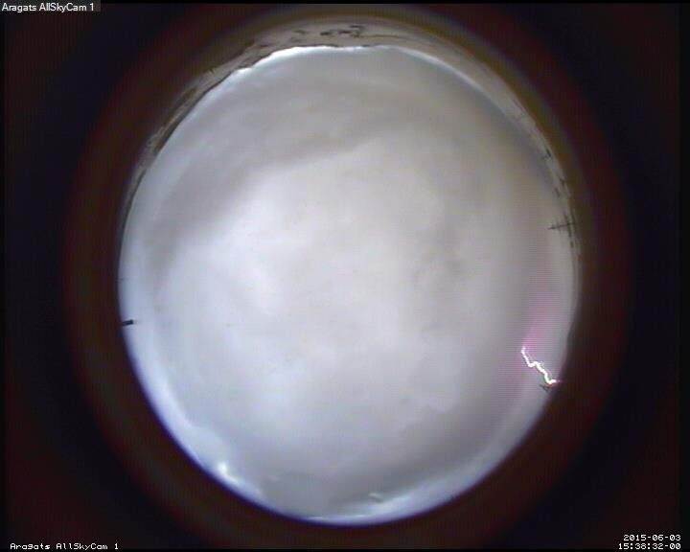
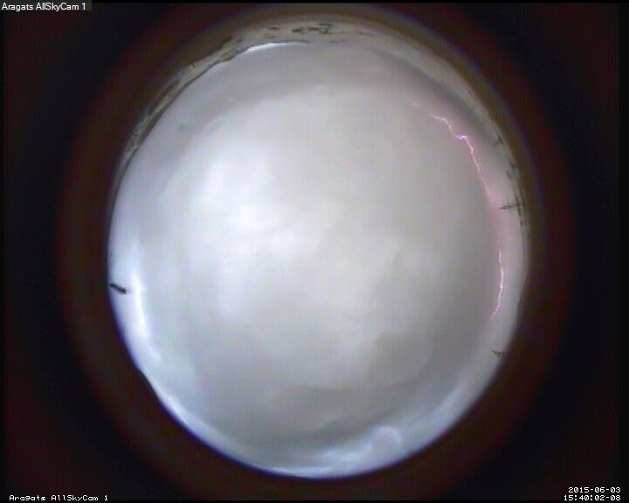
Some Interesting Pictures At Aragats During 2015.06.03

Slide 14
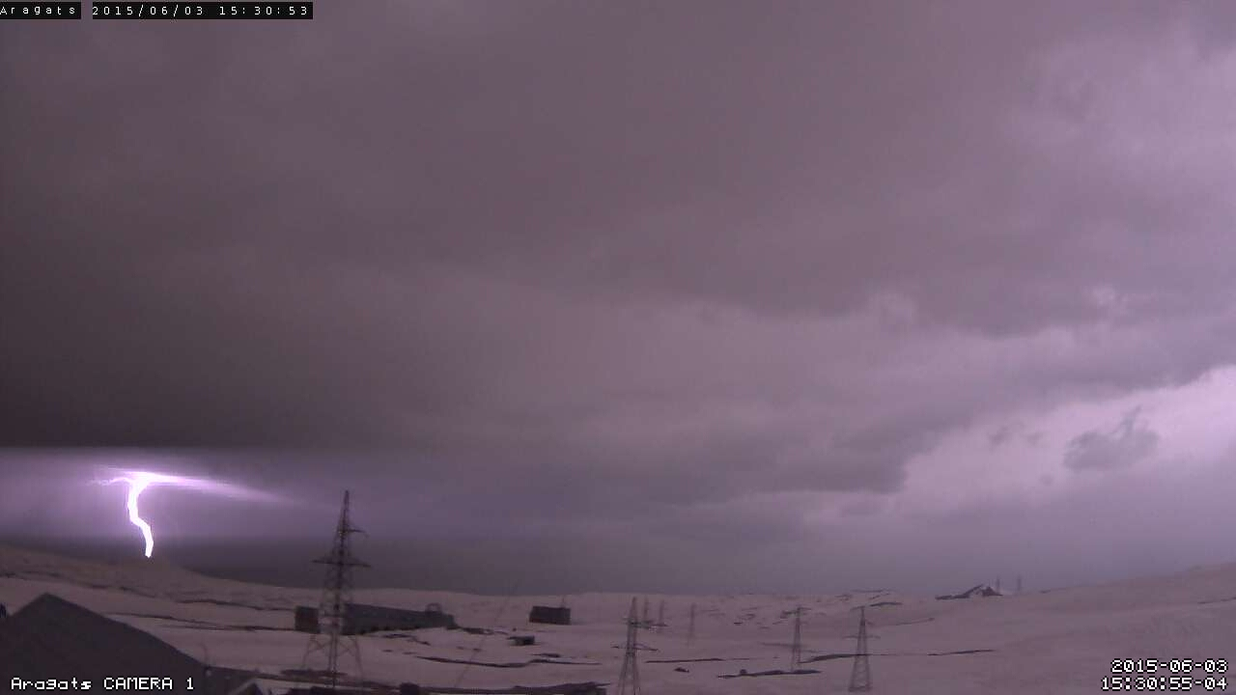
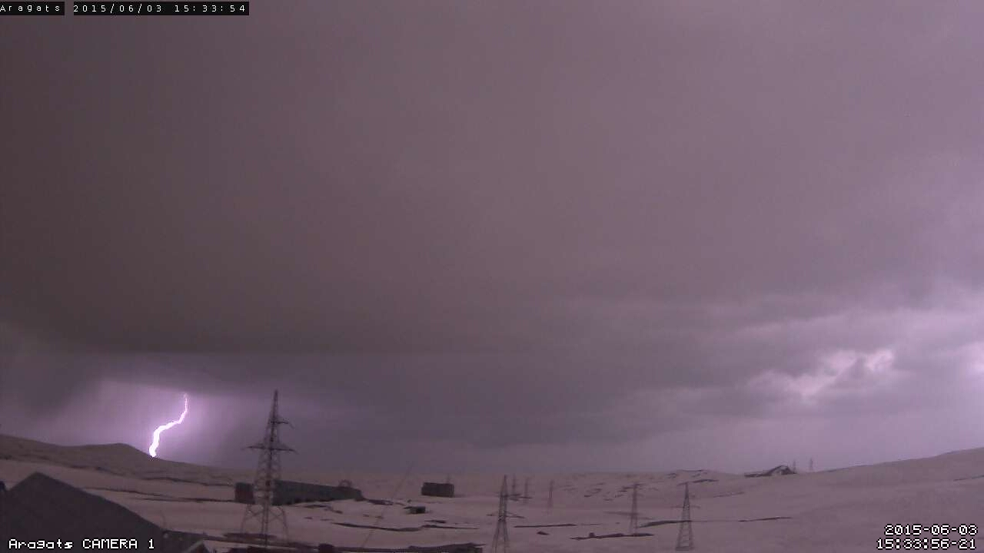
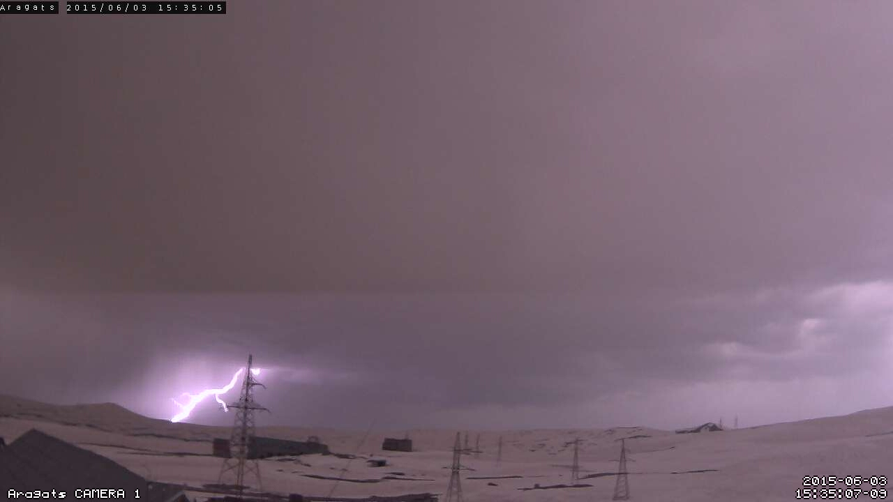
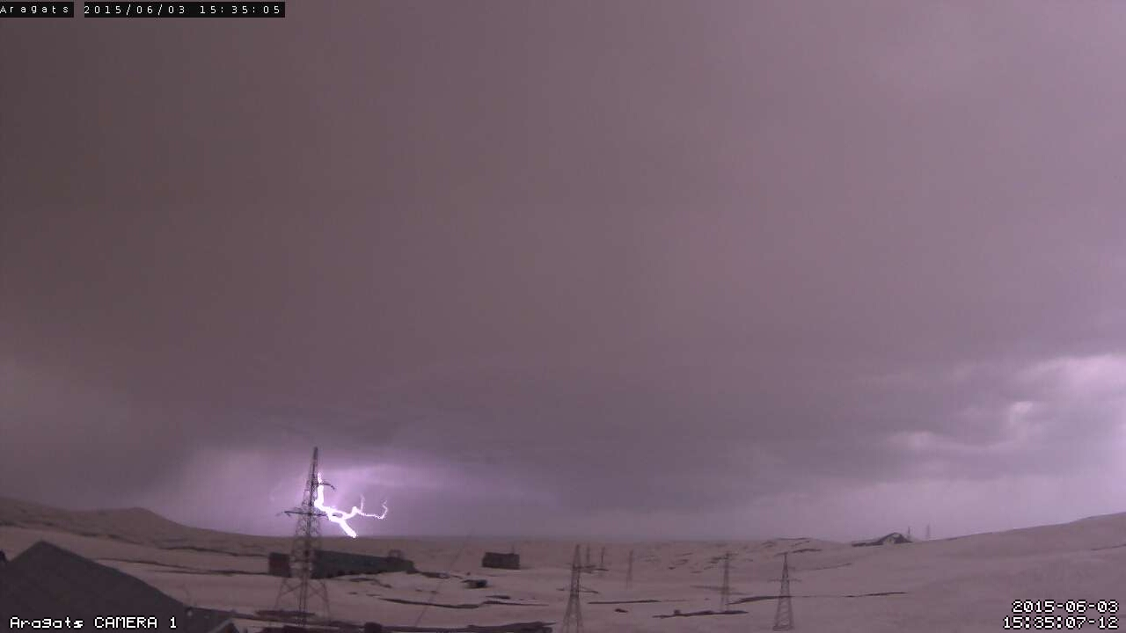
Some Interesting Pictures At Aragats During 2015.06.03

Slide 15
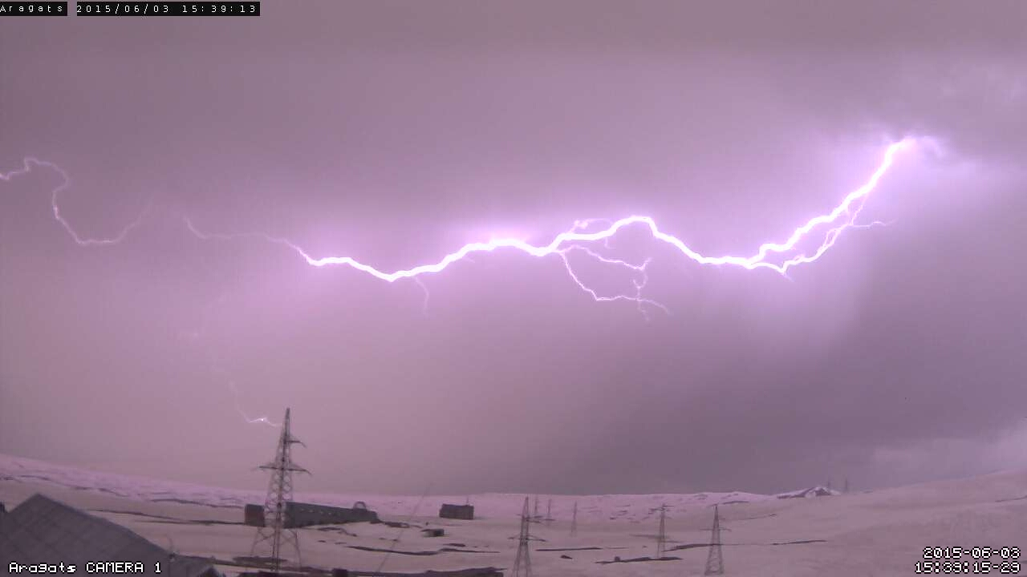
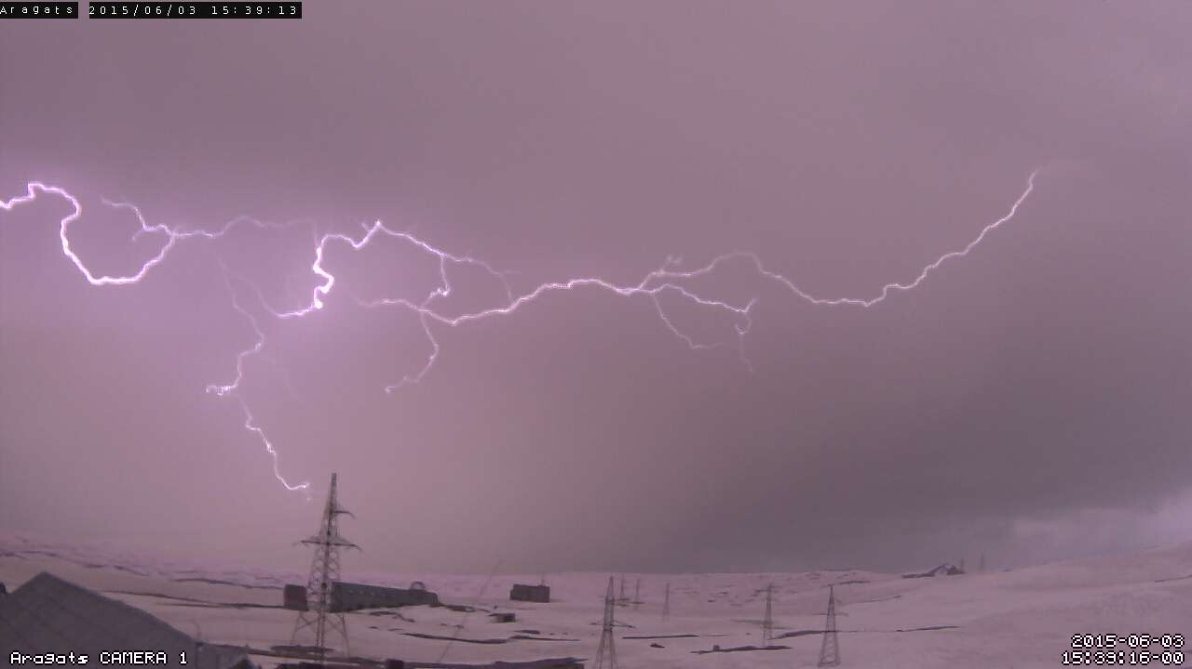
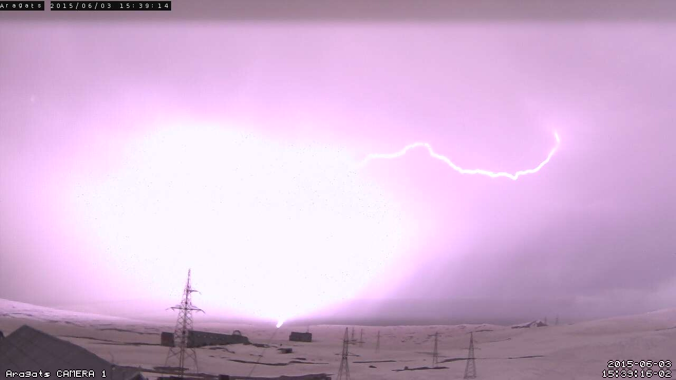
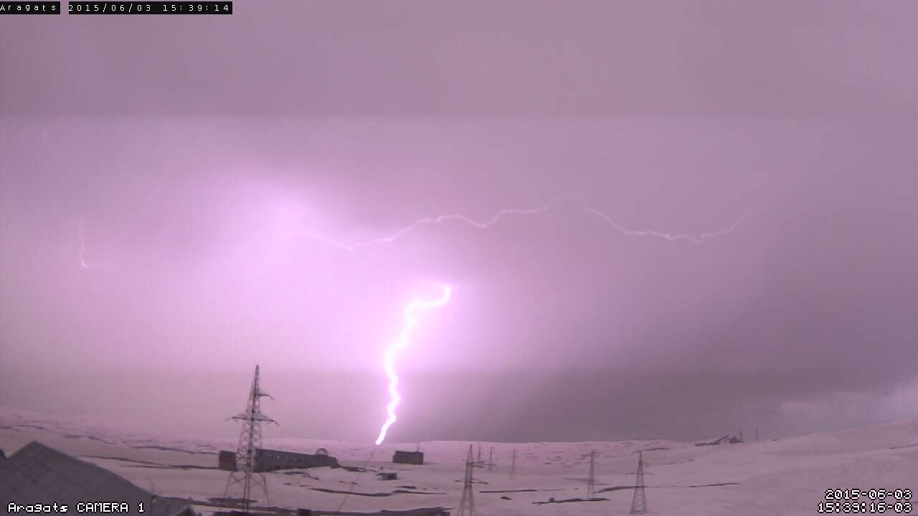
Some Interesting Pictures At Aragats During 2015.06.03

Slide 16
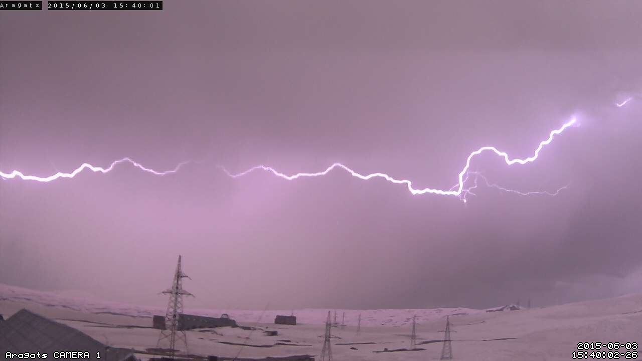
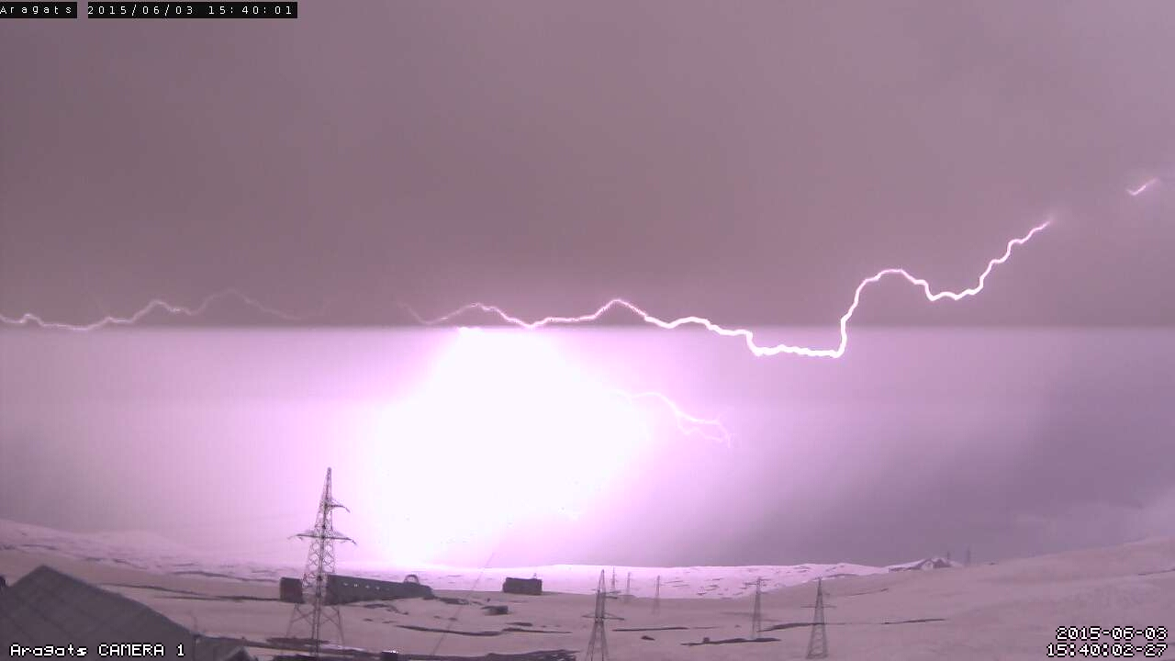
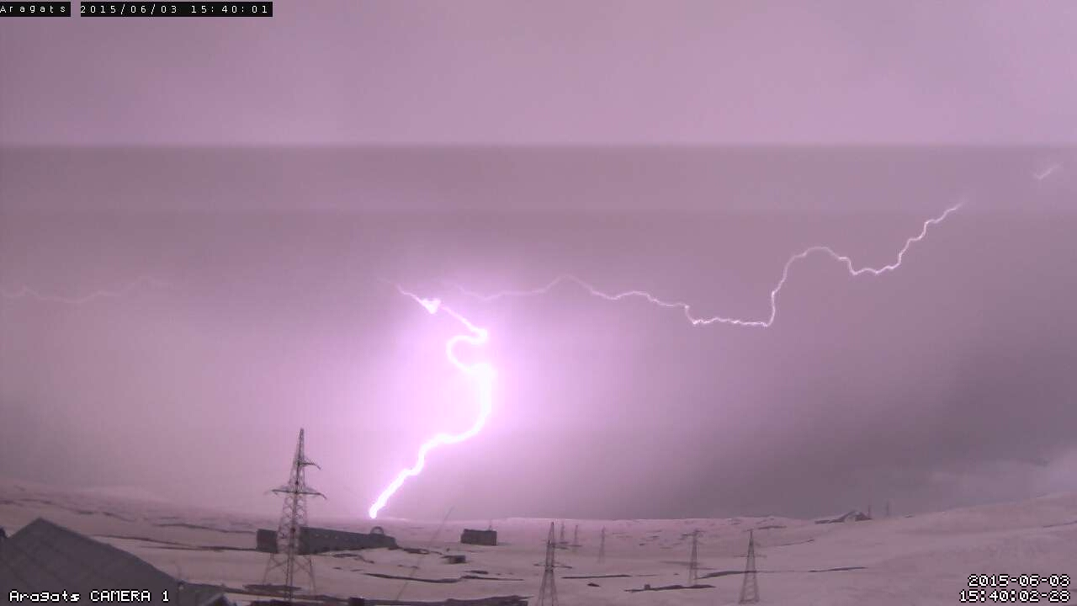
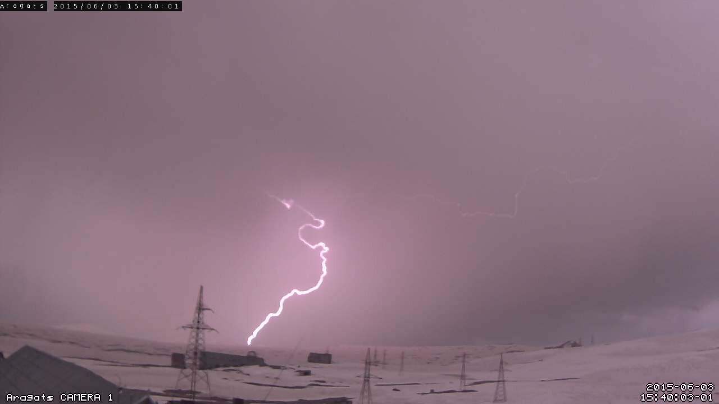
Some Interesting Pictures At Aragats During 2015.06.03

Slide 17
Some Interesting Pictures At Aragats During 2015.06.03

Slide 18
Some Interesting Pictures At Aragats During 2015.06.03

Slide 19
Some Interesting Pictures At Aragats During 2014

Slide 20
Some Interesting Pictures At Aragats During 2014

Slide 21
Some Interesting Pictures At Aragats During 2014

Slide 22
Some Interesting Pictures At Aragats During 2014

Slide 23
Some Interesting Pictures At Aragats During 2014

Slide 24
Some Interesting Pictures At Aragats During 2014

Slide 25
Lightnings Videos From Aragats and Byurakan
Video1, Byurakan 20150523
Video2, Byurakan 20150523
Video3, Byurakan 20150523
Video4, Byurakan 20150523
Video5, Byurakan 20150523
Video1, Aragats 20150603
Video2, Aragats 20150603 (AllSkyCam)
Video3, Aragats 2014
Video4, Aragats 2014

