Slide 1
Largest TGE from30 May 2018
TGE occurred during positive electric field and was terminated by a flash on distance ≈ 5 km.
Energy spectra of electrons extended up to 54 MeV, electrons – 47 MeV, estimated height of decline of accelerating electric field – 90 m.
ASNT vertical count rate shows peak.
SEVAN measured large peaks both in low energies and large energy neutral particles, muon flux declines, especially for declined trajectories (011 – 10%).
Panoramic cameras give good coverage of lightning spots rather good coincided in time and shape (after correcting to the field of view).
However more than 30 second more-or-less stable pattern of spots have to be explained.
Also spots filling total field of view just before lightning also is enigmatic.

Slide 2
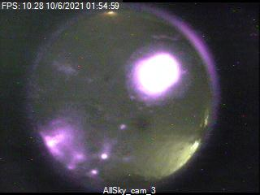
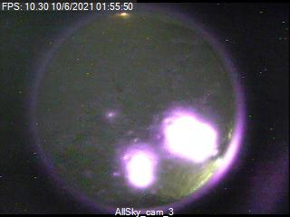
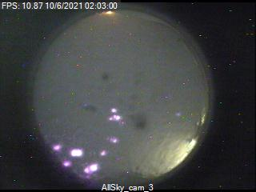
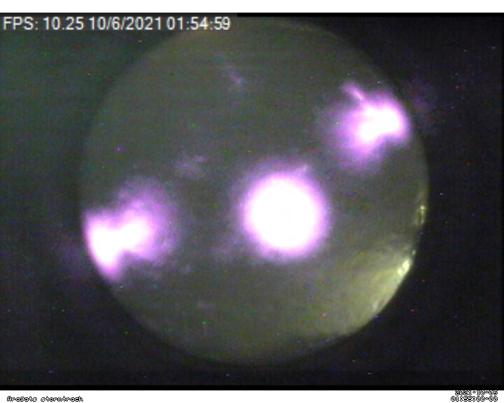
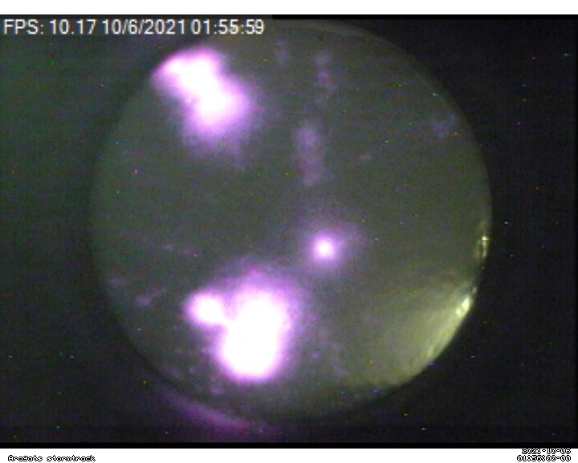
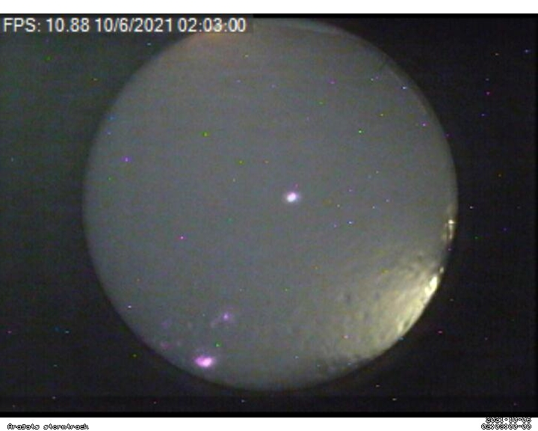
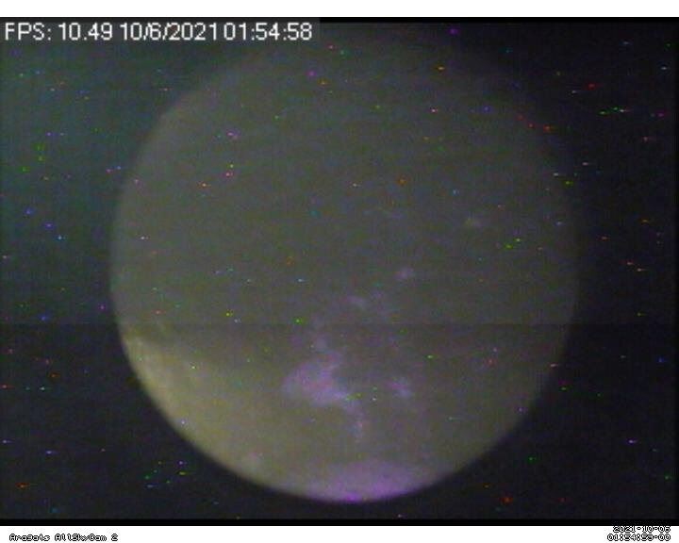
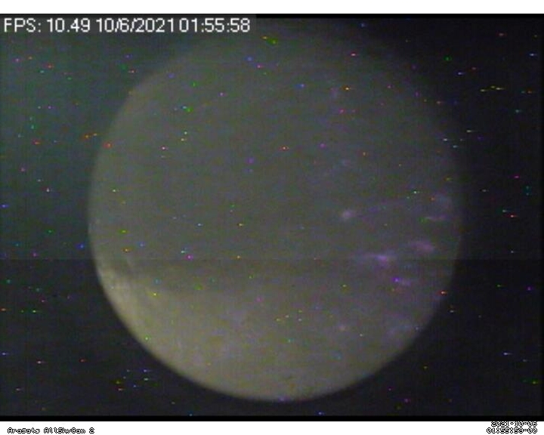
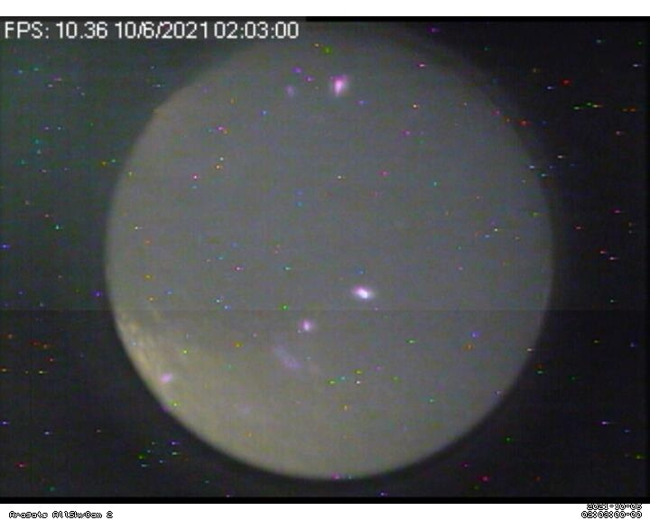

Slide 3
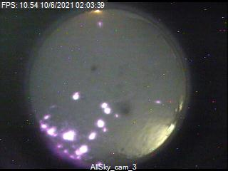
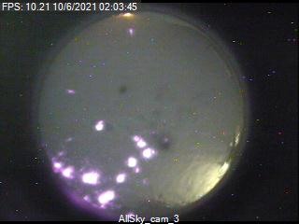
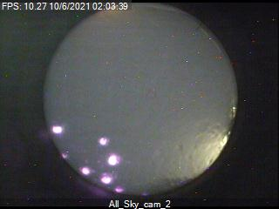
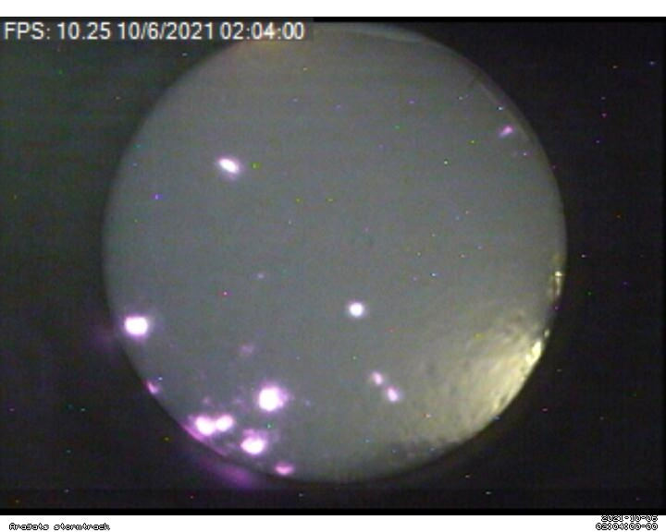
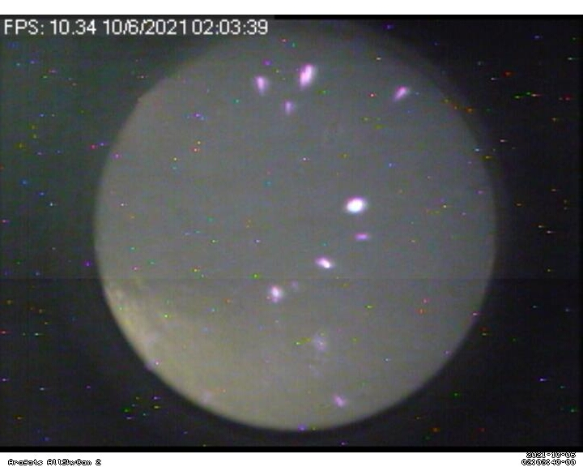
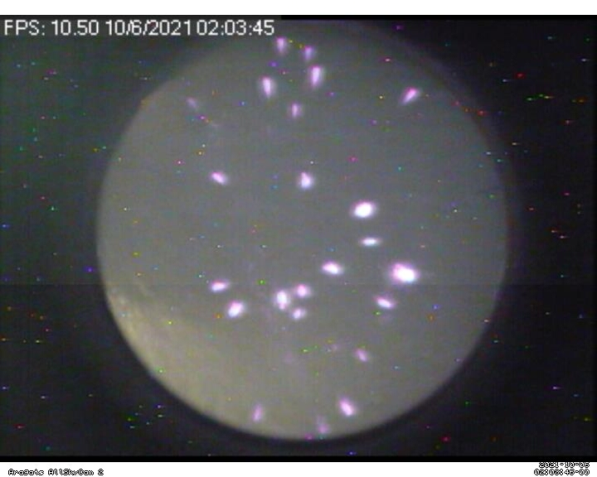
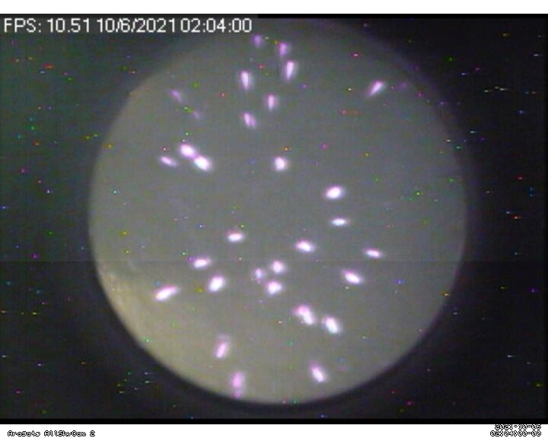
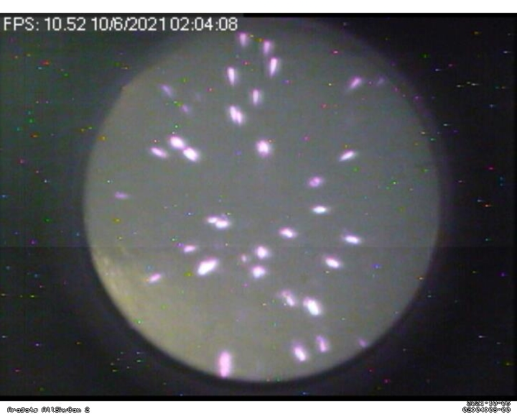

Slide 10
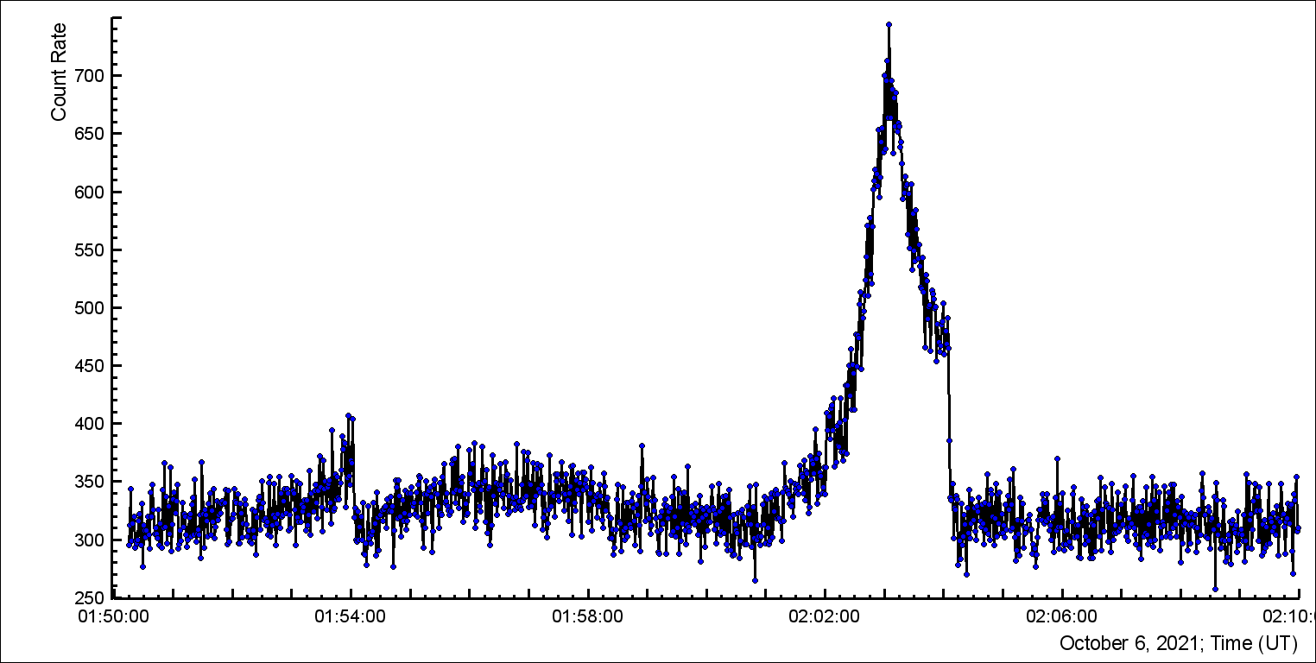
ASNT MAKET 3 cm thick

Slide 11
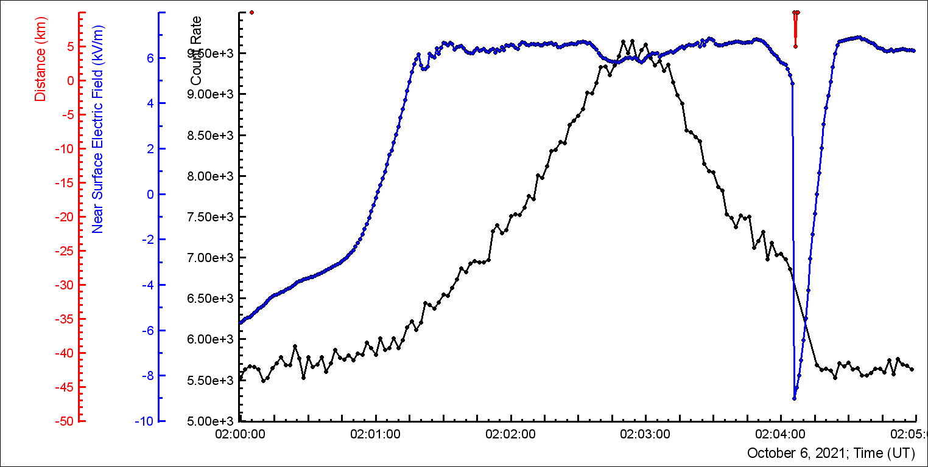
ASNT gamma rays and GAMMA EFM-100

Slide 12
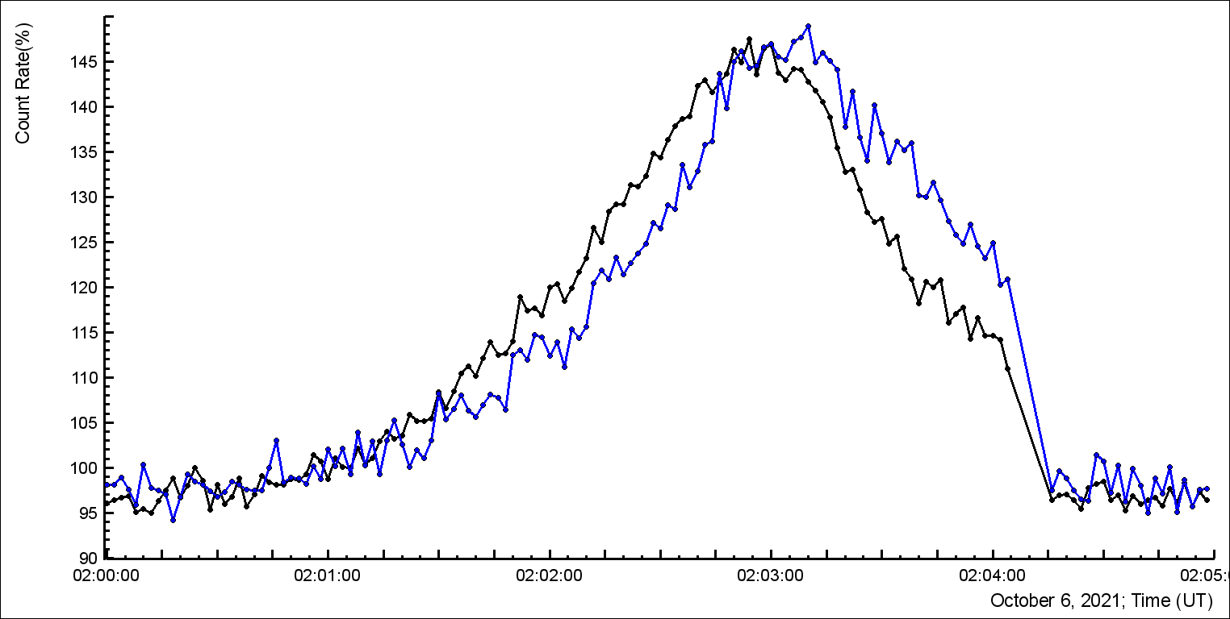
NaI 1 and 3

Slide 13
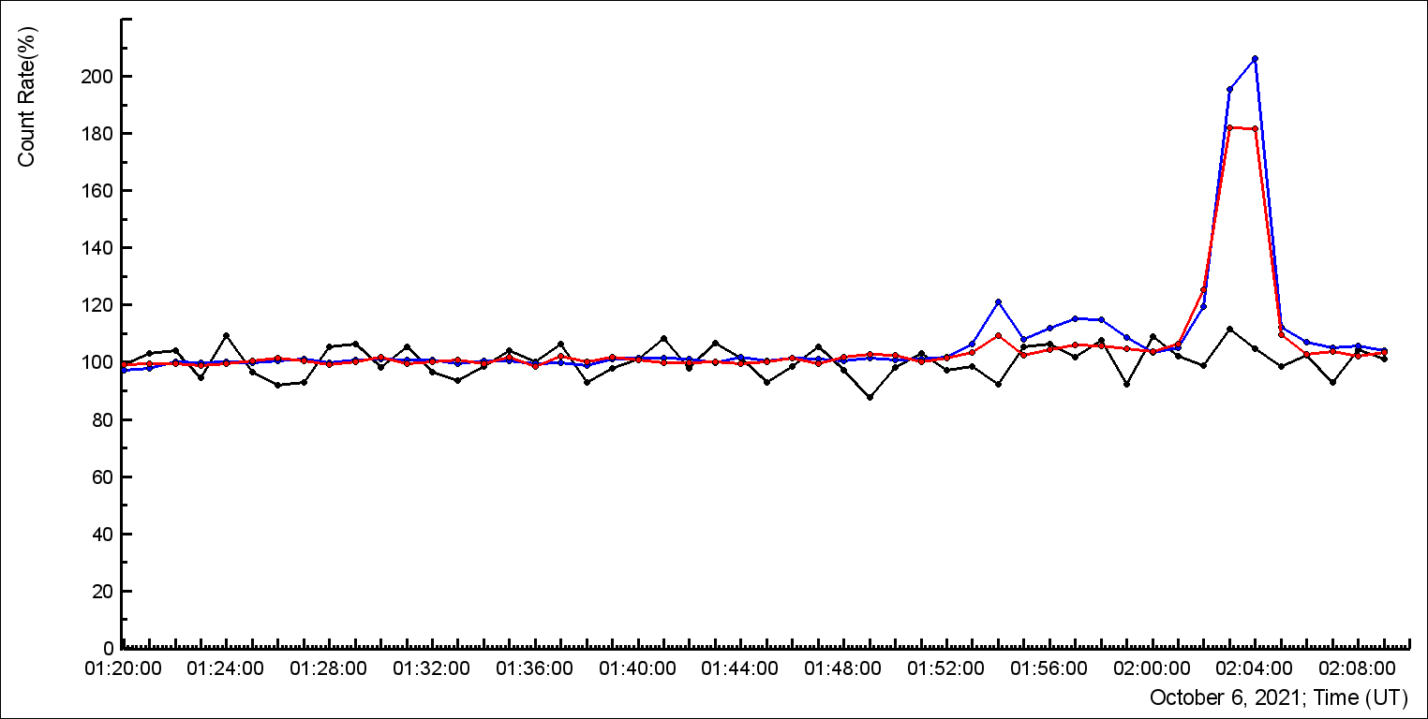
STAND1 111, 100 and 010

Slide 14
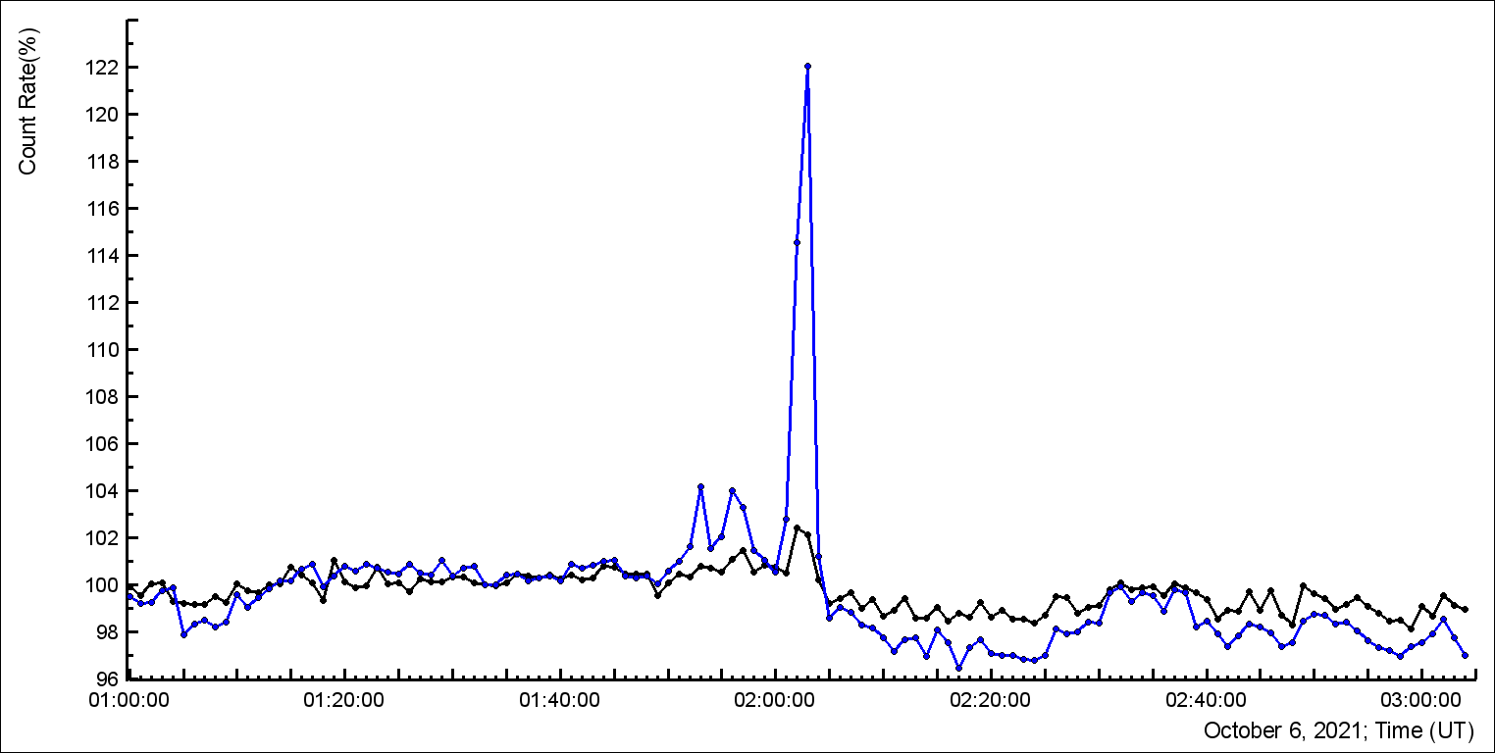
MAKET 60 and 5 cm thick

Slide 15
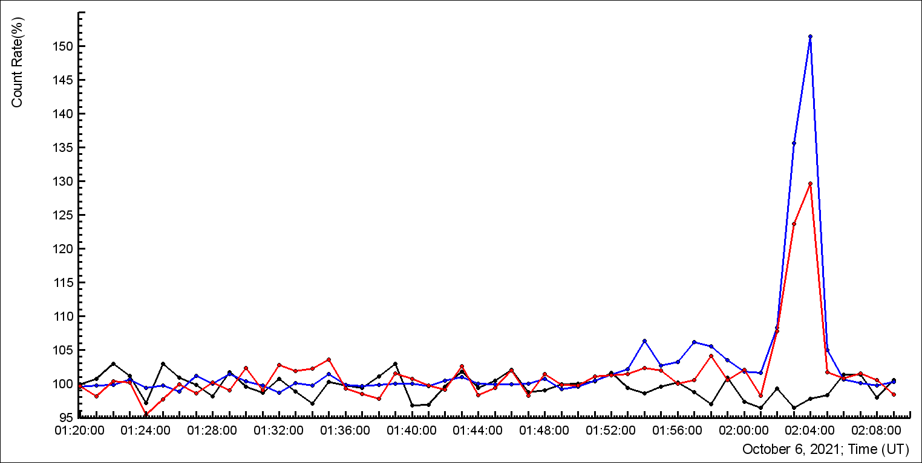
SEVAN 111, 100 and 010

Slide 16
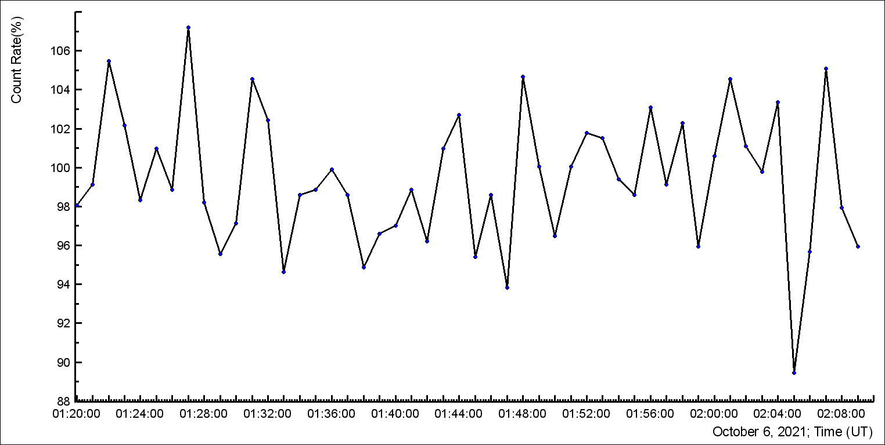
SEVAN 011 – inclined muons

Slide 17
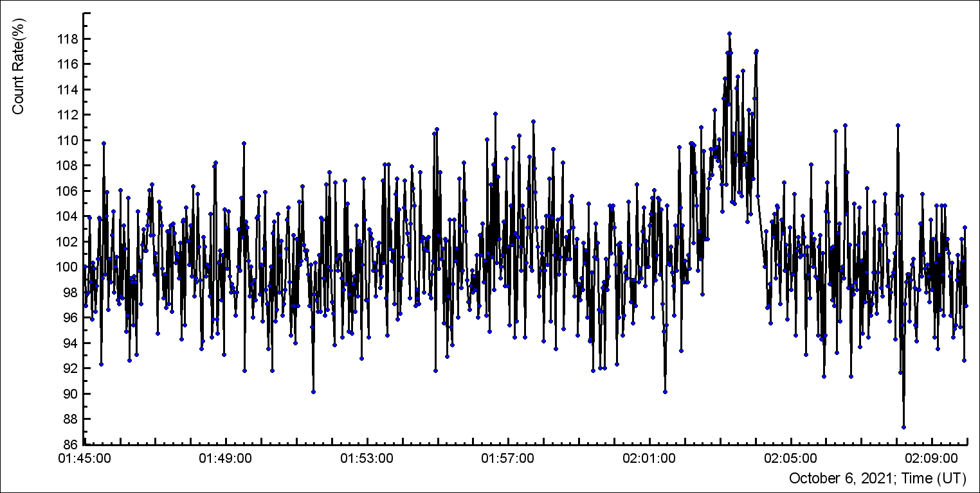
ASNT vertical: coincidence in 5 and 60 cm – electrons!

Slide 18
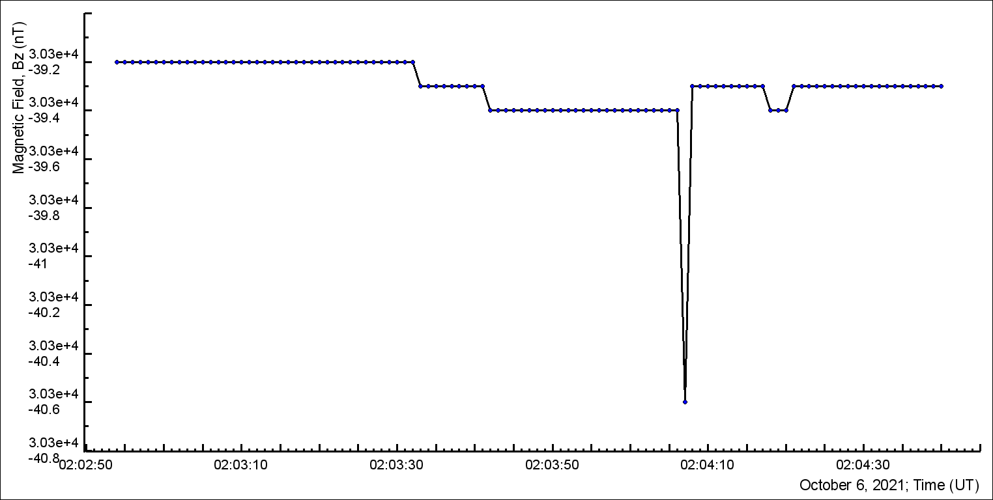
Z-component of the geomagnetic field

Slide 19
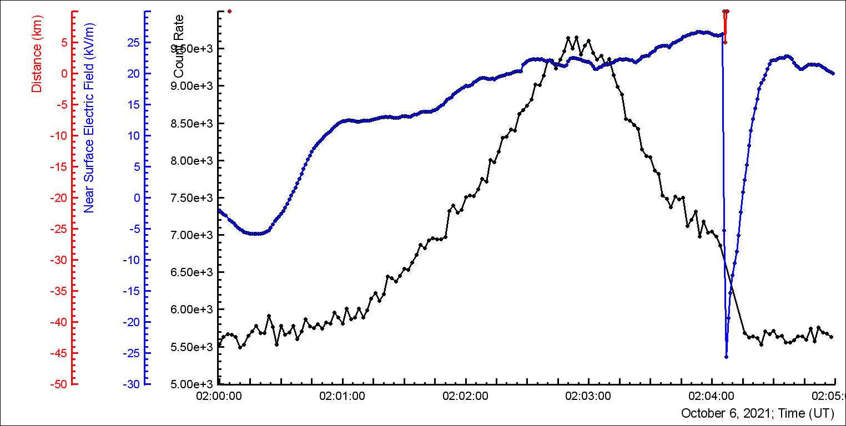
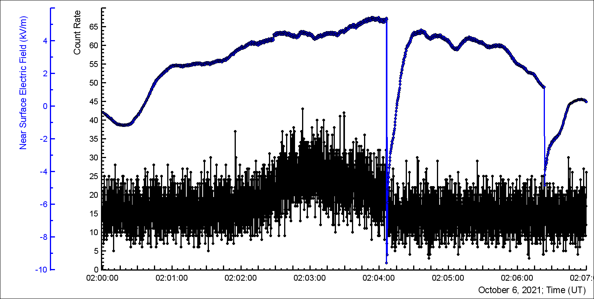

Slide 20
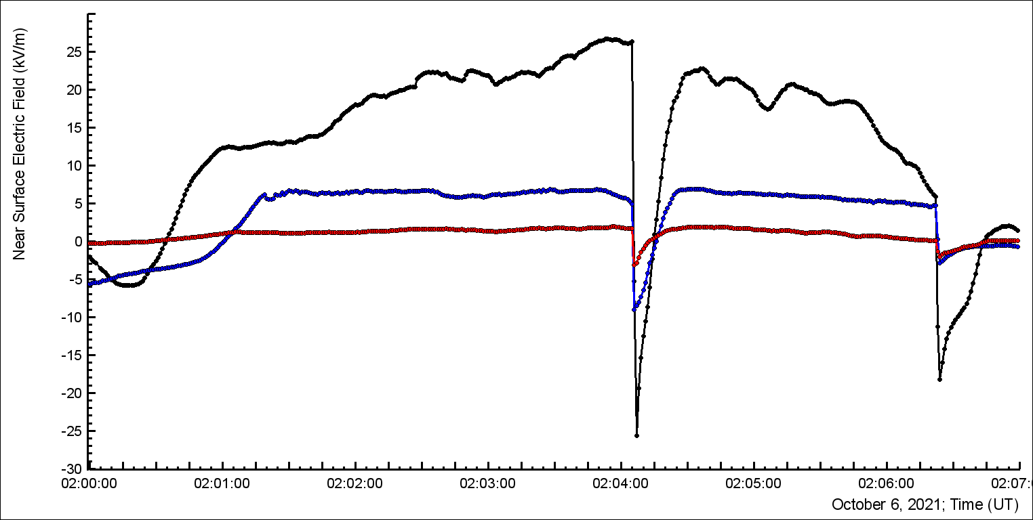
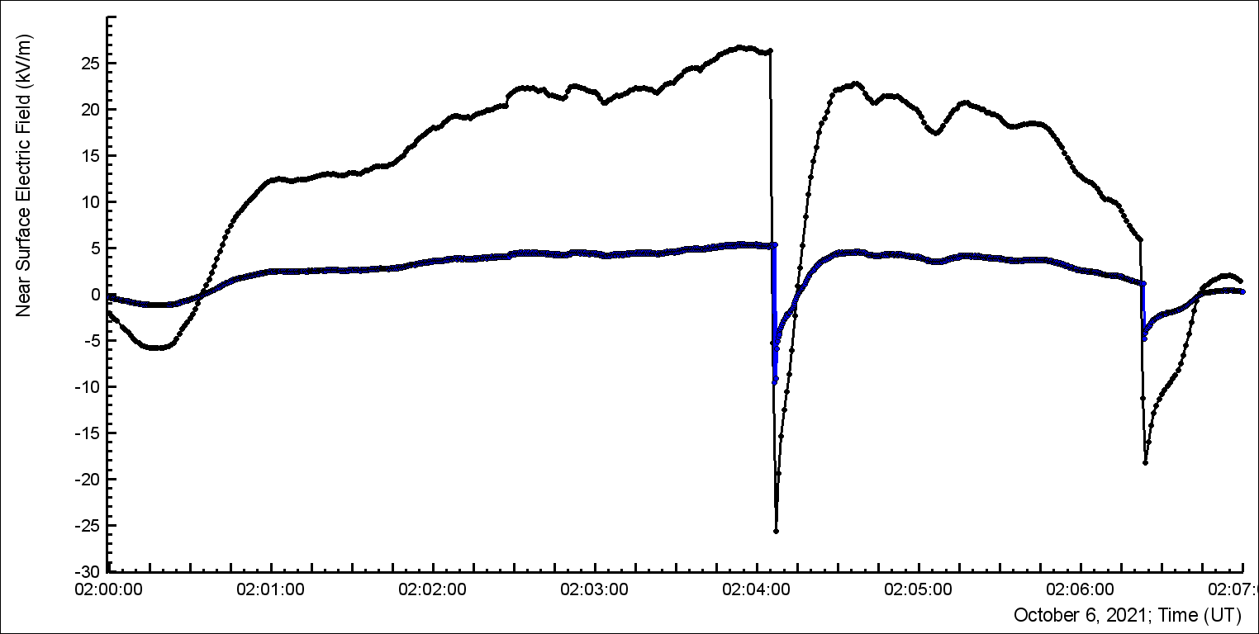
EFM-100 MAKET, GAMMA and SKL; 1 Hz, why so different?
The same EFM-100 MAKET;
30 and 1 Hz, why so different?

Slide 21
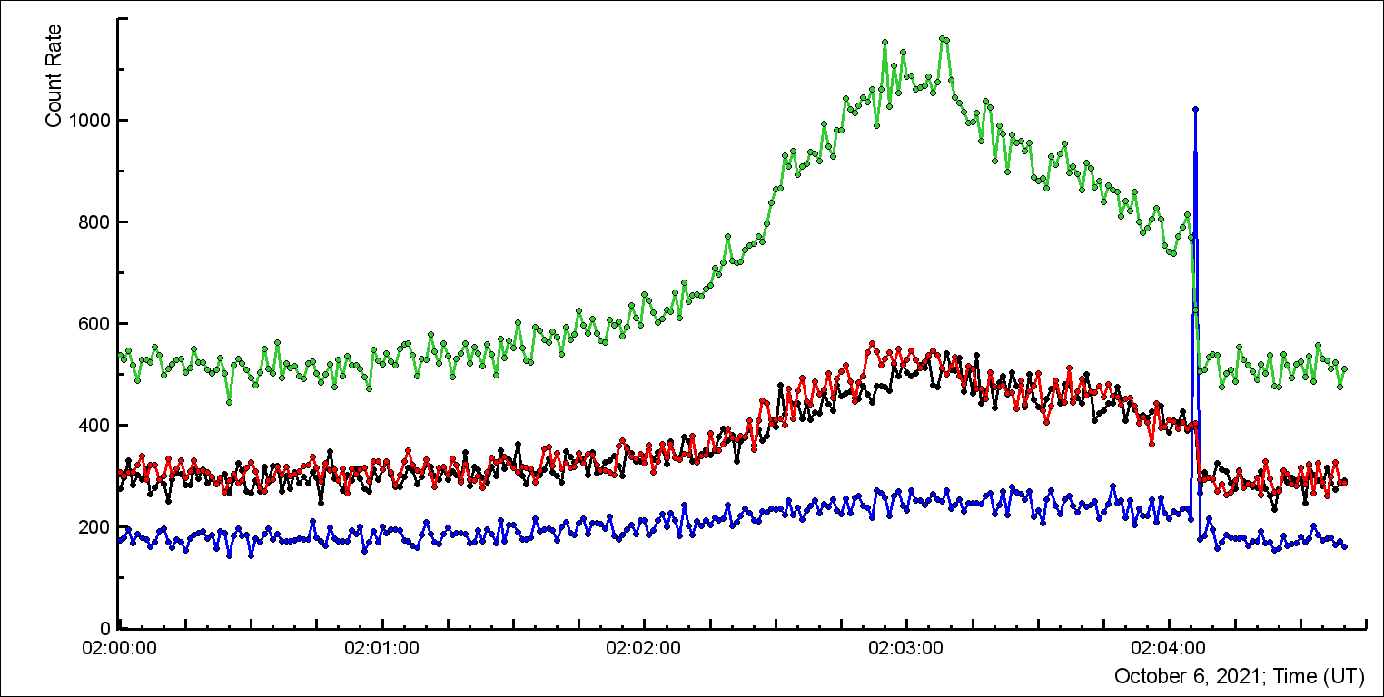
MAKET outdoor 1 cm and 3 cm thick scintillators

Slide 22
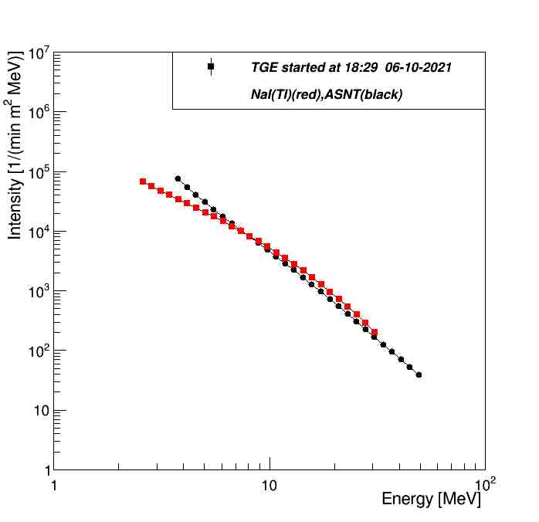
Gamma ray spectra recovered by ASNT and NaI spectrometers

Slide 23
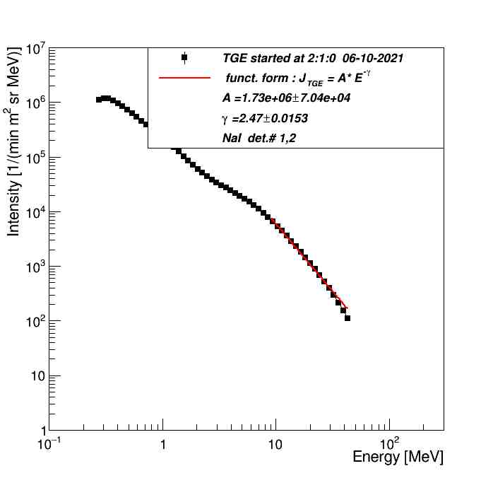
Gamma ray spectra recovered by NaI spectrometer from 0.3 MeV, the Radon progeny contamination is seen

Slide 24
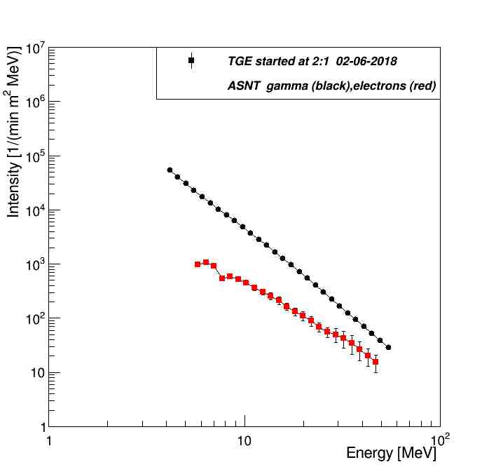
Gamma Ray and electron energy spectra: Max energies 54 and 47 MeV, strong accelerating electric field declined on 90 m above ground

Slide 25
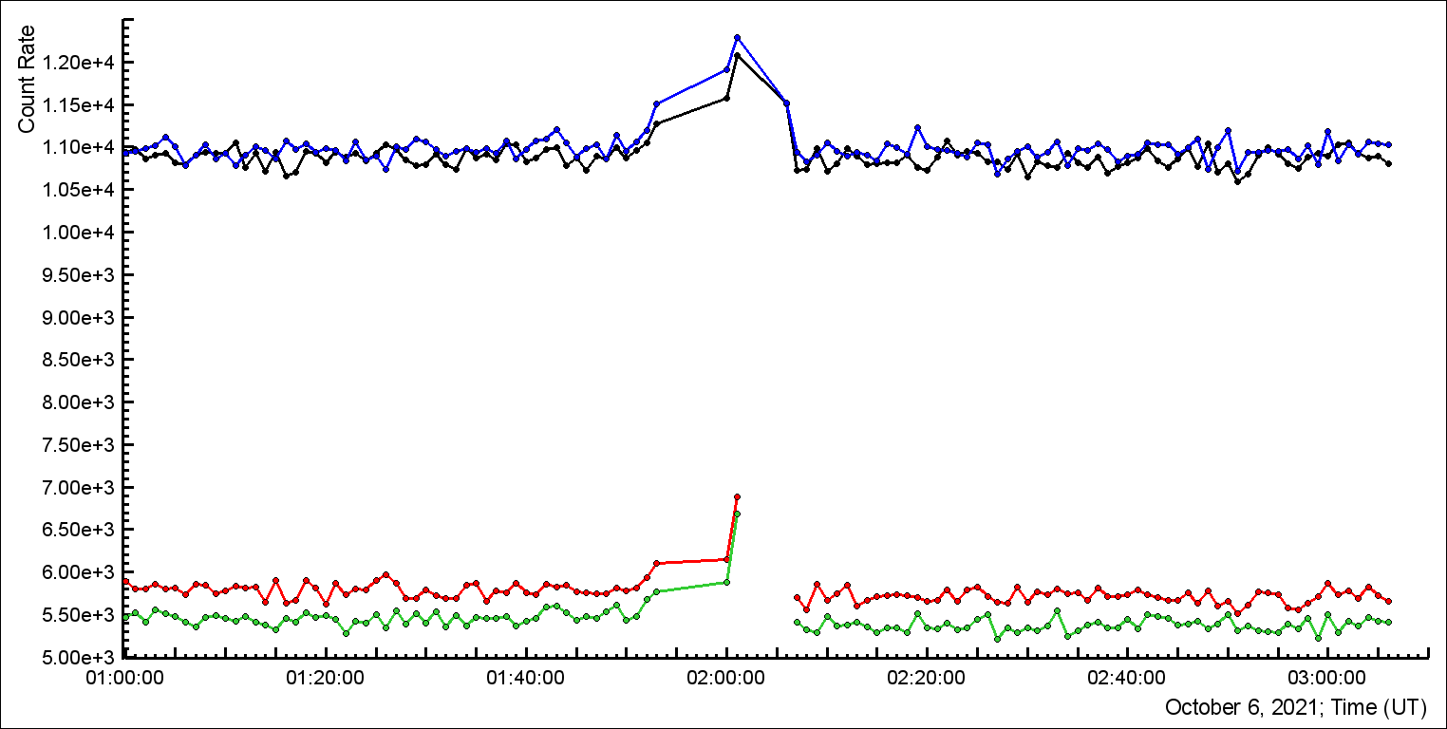
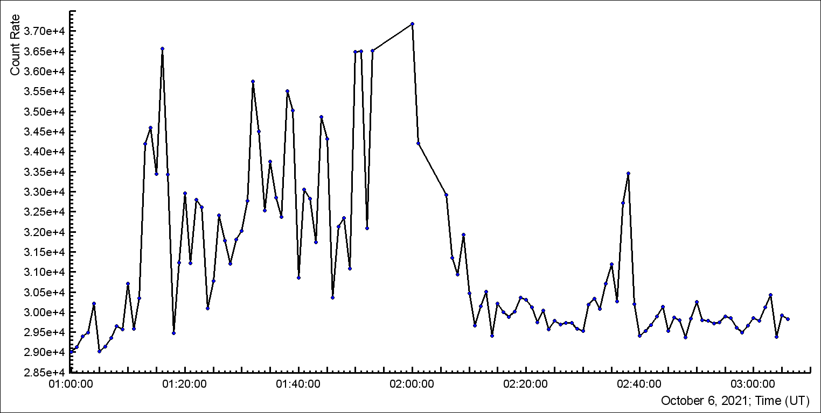
CUBE 7 and 8 with and without VETO
Several minutes are missing!
CUBE N1 VETO scintillator

